Slide 1
,;, /'
s"/,If
\
0 ' >, \' ·
0)
1:.J/ril J,,., ,,
,,._
, '"' , ,,1., I'
s,xc5•
\ \ , , '
11
, ,? ' '
,'
, ,
' :-,
I
\'
.;,,,,,11,11
I J!' - .f ,,,,,.""A -''" " _,,,,,, .,I, A7.1
2 . llor ,, J.f .flt ,,/'
J
./ . lJ . H t "'""
S: .51,uc (He.7e ,.,11n )
0 8°9a
::,
JM.Jt,11
tr,
0 W. fol/Jh
G All,n
,-,,,. ' \ ·
■ P,.ul, CJ,vreh
\ !
' \ \ D J:•;o:I
"'.J I / • I
J. P. f',.,,J,,u )
v '.
•
Jlov5!iftr
'\ / / //,
0 Shu Shop
St/A.VIV/YG 8VILOl/1&5 •
a,., tr, ,MCCu/'OCiilS 117 t/lr;,"lot:M,ent of l>vi/d/,,,/'1
On ,.,,;, fll(l,0 ondM,,ftlet"/,laf" Aof ti// J,.,/Jll'hs s 11ore hc,M9 tn•olo, f'· col ff id111?tll' //'/.$ /i/f (,y #,qr $om 11 oFfht ''.tvr ri rot s• 1u1.- 1rotJ.-A
oaur• le(J t/1s(J110/11d. Ho;,,e.-11r,/,-, tt d l.J"' V/> of bviktillfs lhe All-al 11 11w4u- "1 /11dii:att1tl
.svr., i vols octv.:zl'.J •re $7'1 )11/,,,J•
' ,, , /
,,, ... / ;17
M11
//U.
0.W. ft, //,t •
0 !". Fu:
.,E Jt t,n n
L. Thorn
. l'olu fi A
WHS.n,14
.Yi,l11tli
Thos.
E11lt1r,1•tl ;,,,,,,
r,,,,,,,.,,,1,, a/ "'"I' ,:,/' '-'• ..,.,,,, f,N ,I' Ki".,, t"
o, ,, ,,J , l'l.r , H- Jvr-"•? ,,.,.,,,,. IAt ,,-.,., ,,, ,. ,. ,,f'
H.F /t',.11,-,,J /1..Y., K.l , ,.; AA. bA,,, 16.U. /' x tP'
£,,f J.f /1.1: IY, ff,.,,_,.
IY. w ;Jl,i e
/',- .--, MIIA;.jf" llf"
W1"H1#-, H./f.tu,t1'1N "'­
ltu (y1r,J,- rp Jt.
J. N. S ti !lwell
ROSLYN
... ,,.., .....,
1859

Slide 2
KEY TO WALLING MAP OF MA IN STREET ₂ ROSLYN
1. Van Nostrand-StarkinsHouse (J .M. KirD , 221 Main Street.
Bult circa 1 o. OrigAnal owner not yet identified.
William Van Nostrand was a yeoman who sold the house to
,Joseph St ar ki na, a olacksmith,in 1795 . The house was ex­ tended to the north during the 18th century, probaDly •Y Van Nostrand. There also is an early 19th century wing which was built by Joseph Starkins. The Van Nostrand­ Starkins House is owned ey the Incorporated Village of Roslyn and is rented y the Roslyn Landmark Society und r terms of a long-term lease. It currently is being restored
by the Landmark Society and will »e opend as a house museum.
To the rear of the Van Nostrand-StarkinsHouse is the Jaco•
Kiray Cottage, circa 1855 (22 1 A Main Street) . The Kir y Cot­
tage started life as an independent 2 room strueture. Aaout 1870 it was attached to the Van Nostrand-StarkinsHouse to serTe as a kitch n wing. This operation was carri d out by Capt.
Jaco KirDy who acquired the property on the death-of Joseph Starkins in 1843. Kiray operated a fleet of sloops and schooners etween Roslyn and New York prior to the arrival of the railroad. In 1970 the Roslyn Landmark Society detached the Kirby Cottage from. the Van Nostrand-Starkins House , re-located it and uestored it to serve as a residence.
2 . Warren Wilkie House 1 9 2 Main Str eet . The present house is
conservatively date! to have been Duilt aaout 1865 although
it could have Deen built a few years earlier. A house belon­
ging to Warren Wilkie is shown on the Walling Map. Howeve,r Warren's father, Anthony Wilkie, had owned this land since the Tery early 19th century. Anthony had built an earlier house on the same site which was moved across the pond prior to the
building of the present house. The a.ai•lier house still survives
on East Broadway. At the moment it cannot be established de f i ­ nitely whether the house indicated on the Walling Map is the e ar • lier house before it was moved or the present house. The house, which had eeen empty for many years, was involved in a lanaslide and badly vandalized. It is owned by and is being restored by the Roslyn Preservation Corporatio.n
3. Methodist Parsonage, 180 Main Street. Bull s the parsonage
for the adjacent Wesley Methodist Episcopal Ch.urch in 1843.
Thomas Wood, a local carpenter , was the uilder. The church edi­
fice was burned during the 20th century and the church re-located
in Roslyn Heights. Residence of Mr. & Mrs. Harold c. Mufson.
4. Wilson Williams House
Thomas Wood) 150 Main Street.
The west
end of the house s the earlier. This was built lly Wilson Williams,
a cooper, circa 1770. Williams made the vats for the Onderdonk­
Remsen-Gaine paper m.ill in 177.3 The house was bought by Thomas
Wood, a carpenter, in 1827. Wood extended the house to the e a s t . Thomas Wood was very highly regarded as a carpenter and built a nUI11 ber of houses along Main Street, and elsewhere in Roal yn, during the second quarter of the 19th century. A Roslyn Preservation Corporatic project. Residence of Mrs. Donald P. Burkhar.t The house has been carefully restored by its present owner.

Slide 3
Note:
Between House #4 and House #5 are two houses not shown on the Walling Map but almost certainly built before its
1859 publication date. The map is a large one and includes all of the present Kings, Queens and Nassau Counties with many det0ils of towns and villages as the map of oslyn.
Since most of these areas had not previously een mapped in as ₁great detail it is likely the ma took several years
prepare. For this ee son a house built as early s 1856
or e ve'n 1855 might not be shown on the map . The two houses
are: 1
I
148 Main Street. Circa 185.5 Designated
Samu 1 Du an I House
int s manner to distinguish it from Samuel Dugan, Jr'•• house whiq still stands on East Broadwa.y Samuel Dugan was a highly acc6mplished local stone-mason who immigrated from Belfast, Nor,'th Irelan,d about 18.50 . He bullt the original stone .railroa bridges in Roslyn. He alaost certainly built the stone founda­ tion of the warren Wilkif' House which is as sound today as when the house was built notwithstanding the house's ,inundation in
a landslide which deposited 26 f'eet of' gravel around the house. A Roslyn Preservation Corporation project. Residence of Mr. & Mrs. Leonard Blum. The house was carefully restored y its
pre sent ow&n rs.
John s. Wood House, 140 Main Street. Circa 1855. John s. Wood was the son of Thomas Wood whose house has een descri ed at,ove • Like his father, John Wood was a carpenter. Proba ly he was associated with his father in the construction of many of the Main Street houses. Jta.ai:ua««.xa:RxJ!haxhbax.x1ilimmuixxxgx Almost certainly he built his own house in association with his father. Residence of Mr. & Mrs. Edmond H. Ilg.
5. John Williams House
W.H. Cornell 130 Main Street. 1790-1800.
Bu t by John W l ams, son of W laon Williams who lived a few
houses to the south. Originally there were no houses between the two houses. Residence of Mr. & Mrs• .Brnest G. Dunnet.
6. John Hendrickson House (Samuel R. Ely, D.D.)₁circa 1830. Virtually
nothing ls known of John Henarlckson except that, probably, he was
the original owner or the house which, probably, was built ay Thomas
Wood, the c arpent er. Reverend Samuel R. Ely was the minister of the Roslyn Preseyterian Church from 1854 to 1870. o viously he had other income beyond the ministerial as the house wes one of the
most ambitious of its day. He was Q Princeton alumnus whosw1D1 reputation extended beyond the local area. His biography ls in­ cluded in Appleton's Cyclopedia of American Biography (1838).
Residence of Mrs. George E. Br owe r . &JUlxJtt.aa Restored and enlarged
y present owner.
7. Ca
s Smith House William H. Smith 106 Main Street.
Ci
Original owner of house was James Smith, the local
tailor, who was the Commanding Officer of the Hempstead Har or­
Flower Hill Militia Company du.ring the War of' 1812 . The house
was purchased by William a. S mith, the local blackamithg who was
not related, in 1856. The house re ained in the ownership of the latter's descendants until the summer of 1971. Owned by Dr. & Mrs. Roger Gerry. The house is presently under study preparatory to its early restoration.

Slide 4
8. Obadiah Washinton Valentine House w. Valentine) 105 Main Street.
Circa l 3 . ash!ngton Val ntine operated his family's paper
mill until his death in 1854. The house remained in the owner­
ship of the Valentine family until the sale of the William M. Valentine holdings early in the present century. Almo t cer­ tainly the house was built by Thomas Wood, a local carpenter. Residence of Dr8 & Mrs. Roger G rry. Restored by present owners.
Myers Valentine House, 83 Main Street. Built 1840-1845. En­
larged 1865-187,0 probaDly y John Wood, a local carpenter.
Myers Valentine took over the op ration of the family paper mill
following the death of his brother, Obadiah WashingtOl'l, in 185.4
Residence of Mr. & Mrs. Donald o. Horn.
10. Leonard Thorn. Two houses owned by Leonard Thorn are shown on the :ma pD together; Thorn owned a large livery stable and was the local mortician. Xuxaxkxhxha
#94 Main Street. Residence of Mr.
Built about 1825 with aome later additions.
& Mrs. Joseph H. Brown.
#88 Main Str ee t !. The larger of the two houses. Built c i r c a
1840 with later additions. Residence of Mr. & Mrs. John
J ., Mro el and . Restored y the present owners•
11. Henry W. Eastman House, 75 Main Street. The original south
section was Duilt 1815-1 20 oy an unidentified owner. Henry
Western Eastman enlarged the house to the north about 1870 and his descendents enlarged it furthe in the same direction about 1890. Henry W. Eastman was a prominent local lawyer who served as President of the Bar Assooiat:i.on of Quetlns County, which at
that time included Nasdau . He was the co-publiflher of the Roslyn Plaindealerp th.e fl i•s t local newspaper, during 1850-1852. He was one of the fouqders of the Roslyn Savings Bank. Residence of Mr.. & Mrs. Karl B o Ilo ltzschu.e The house was restored by its
:present owners.
Dr. Furman Field House 76 Main Street . Probably built ay another prior to Dr. Field's ownershi.p Dr. Fielrl was the local doctor during the third quarter or the 19th ceatury. The house was built a&out 1830. Residence of Mr. & Mrs. Maro Brugnonei
12 .
13. Henry W. Eastman Law Office, 55 Main Street.
Circa 1850.
Originally built as a residence but served for many years as
the offices of Henry Western Eastman, who lived next door ai
75 Me.in S treet. The building served as the office for the first Hoslyn newspaper, The Pilainde ler (18$ 0 - 185 2 ) . The Roslyn Savings Bank started operations in this building, in 1876, and functioned there for many ye ar s . The original brick
ank vault, in the Gothic Style, survives. Owned by Charles
Soloman..
O. W a Pollitz House. One of two houses owned by O. W. Pollitz
shown on map. House is 4ituated on hillside above Main Street.
It was built about 1855. The Pollitz family im. 1grated from Belfast, North Ireland, about 1840. Residence of Mr. Alfred Edwards.

Slide 5
15. John Mott House, 60 Main Street. 1835.
Proba ly·Thornas
Wood was the carpenter who ·uilt this house. Residence of
Mr. & Mrs. Thomas H. Shilson.
16 . George Allen₂ Two houses are shown, both keyed to the sa!rle
n ame:.
36 Main Street.
Augens t ei n .
Built about 1840. Property of Robert
20 Main Street. Built about 1830. Residence of Mr. &
Mrs. Albert Pagnotta.
o.. W . Pollitz Hous •
This is the second of the two Pollitz
houses which are listed individaally on the Walling Map.
Like the ot her , this is sit ated on the hillside a ove Main Street. It was built about 1850. The Pollitz family immigra­ ted from Belfast, North Ireland, about 1840. Probably this house wes their actual residence. A son, John Codman Pollitz, who died during the Civil War, saved his pa7 as a soldier in the Union Army to uy the bell for the original Trinity Church. Residence of Mr. & Mrs. Walter Ogle.
John Willis House, 18 Main Stree t. Circa 1835. John Willis operated the grist mill for several y1itars during the 19t h century in partnership with George Allen. Owned by Anthony Bretone.
19. Leonard Thorn SbopL 23 Main Street. One of a group of early
19th century shops, probably uilt circa 1840. Leonard Thorn opa sted a livery stable and was the local mortician. Owned y Marilyn K. Sha¥.
20 . A. Kilpatric Shop, 21 Main Street. One of a group of early 19th century shops, proba ly built circa 1840. Own d y Marilyn K. Shaw .
2 1 . Mrs. Kir y's Shop, 19 Main Street. One or a group or early
19th cen.tury shops, probahly bu.ilt circa 184.0 Owned by
Marilyn K. Shaw.
2 2 .
Jean Pine House (D . Bogert). Inter8ection of Main Street &
Old Northern Boulevard. House forms the northern terminus of
Main Street. Built by Jean Pine, a Frenchr.!an , in 1744. Probably
should be called the Hendrick Ondcrdonk House, in honor of its
owner for about 40 years starting in 175.4 Hendrick Onderdonk
owned most of Roslyn during the second half of the 18th century.
including the Grist Mill, the Peper Mill, and a large general store. He was visited, in this house, by General George JU.llhgx1 Washington in 1790. Since Hendrick Onderdonk's time the house
has been very much enlarged. Owned by Henry Hermsnse.n

Slide 6
Numbers 23₂ 24, & 25 are not on Main Street but are closelI related to i t .
23. Grist Mill₂ 1347 Old Northe1•n Boulevard.
Built by John
Robison and his sonsp probably prior to 1710. Except for its
sheathingp the mill has survived in an almost intact state and still retains much of its 18th cbntury milling aap1ipmau machinery. Authorities agree that it actually was constructed by a Dutch millwright or one who was trained in the Dutch tradition. It is the only surviving commercial building of Dutch origin in the U.S. Not a single early 18th century water mill has survived in Hol·land. Owned by the Gr-ist Mill Historical Society.
William M o Valentine House, Paper Mill Road . The house appears on the map to be located on East Broadway. Actually, it is some­ what west of last Bnoadway. It was moved across the Paper Mill Road in 1968 to make room for the expansion of the Bryant Library o
.it.tax. It2 original location y,:as even further to' th-e wes t . The
house probably was built by William Valentine about 1801, although it m&y have been Duilt y Hendrick or Anderis Onderdonk a few years earlier. It was enlarged oy William M. Valentin,e a son of William, e.bo\lt 1863 . William. Valentine purchased 'and operated
the Onderdonk-Remsen-Gaine paper mill about 1801. His son, William M., had a bl general merchandise establishment in a large brick building which still snrvives at the corner of Main Street and Tower Street. This building was built in 1862. The William M e Valentine House was restoPed by the Incorporated Vil­ lage of Rosl yn,bxz azxa in 1963, to serve as a Village Hall and a house museum. It has Deen mentioned that it was moved across Paper Mill Roed in 1968.
BnderdonkRemsen-Gaine Paper Mill, Paper Mill Road about 200 feet east of Main Street. The paper mill was built by Hendrick Onderdonk, Henry Remsen and H1gh Gaine in 1773. There is substan• tial basis for belieTing it to be the earliest paper mill in New York State. The present building is a replica of the original which colla sed early in the present century. The replica was
comple4ed in 1 91 3 . Hendrick Onderdonk owned most of Roslyn during the second half ofi the 18th century. Hugh Gaine was a prominent New York print r and puolisher who foundedx the New York Mercurz in 1752 and published it for a number of yea s. Property of the Town of North Hempstea d.
26.
Kirb •s Corners ( J o M. Kirb o Jacob Kirby was the owner of a feet of &chooners and sloops which carried passengers and mer­ chandise between Roslyn and New York during the years prior to the arrival of ther ailr oad. By the mi d- 19t h century he owned all the property around the intersection of Main Street and East 3raadway; including the Van Nostrand-StarkinsHousep which he
enlarged. There are two structures indicated in black on the map . One of these is a tiny, mid-19th century house, now included in a new house₉ at 2it4 East Broadway. This house is the residence of Mr o & Mrs. 6.. W, Sammis. The other bu1lding₉ f cing Main Street,
!s a mid-19th century Kirby warehouse. It does not have a street
num.ber.

Slide 7
The following buildings, on Main Street, do not appear on the Walling Map and were built after 1859. Howeve,r they were com­ pleted before the end of the Civil War.
219 Main Street. Built by Captain Jacob Kirmy, circa 1860 . It
presnntly is the residence of Mr. & Mrs.. Rot.ert A o Hans n.
122 Main Street. Built by W o H o Co rnell about 1860 . It now is the residence of Mr. & Mrs. Robert E. Abrams.
William M. Valentine Store. A large brick building at the intersection
of Main Street & Tower Street built y William M o Valentine in 1862•
William M o Valentinev s House survives in Roslyn Park (see #2! ). Owned by Marilyn K. Shaw.
Henry Western Eastman Cottage. This tiny cottage situated between numbers 11 & 13, but back from the street, is right on the line.
Probably it was built when #ll was enlarged. This could haYe been
as early as 1860-1865, but ay •R have been as late as 1870. I have
tried to be as conse vatlve as possible in dating. tloth cottage and
addition are depicted on the Beers-Comstock Map of 1873 which probably
waR drafted a year or two earlier. In other words, both cottage and addition are no later than 1870 and may be as early os 1860.

Slide 8
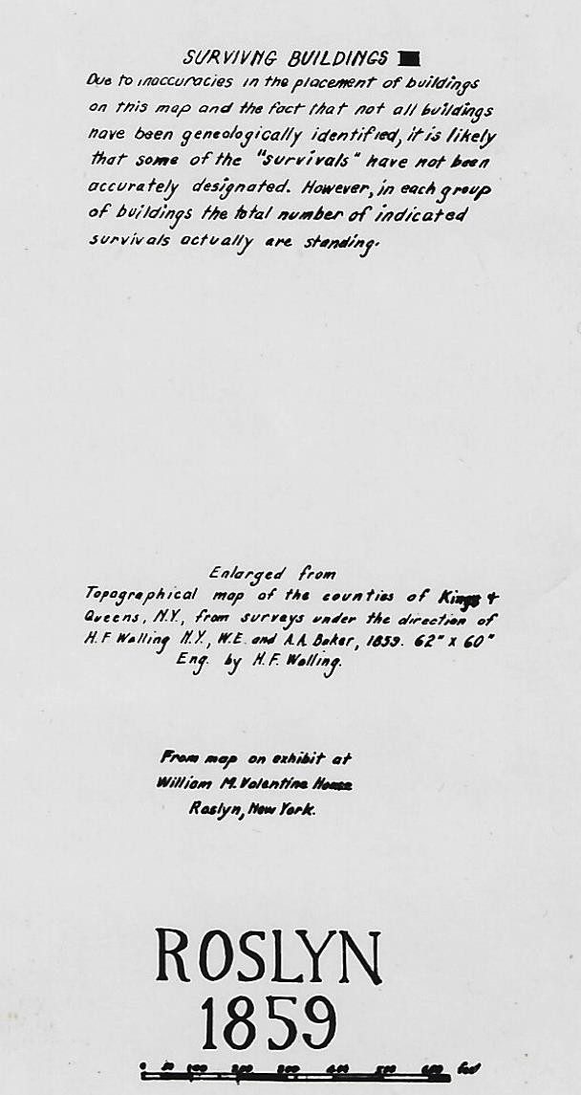

Slide 9
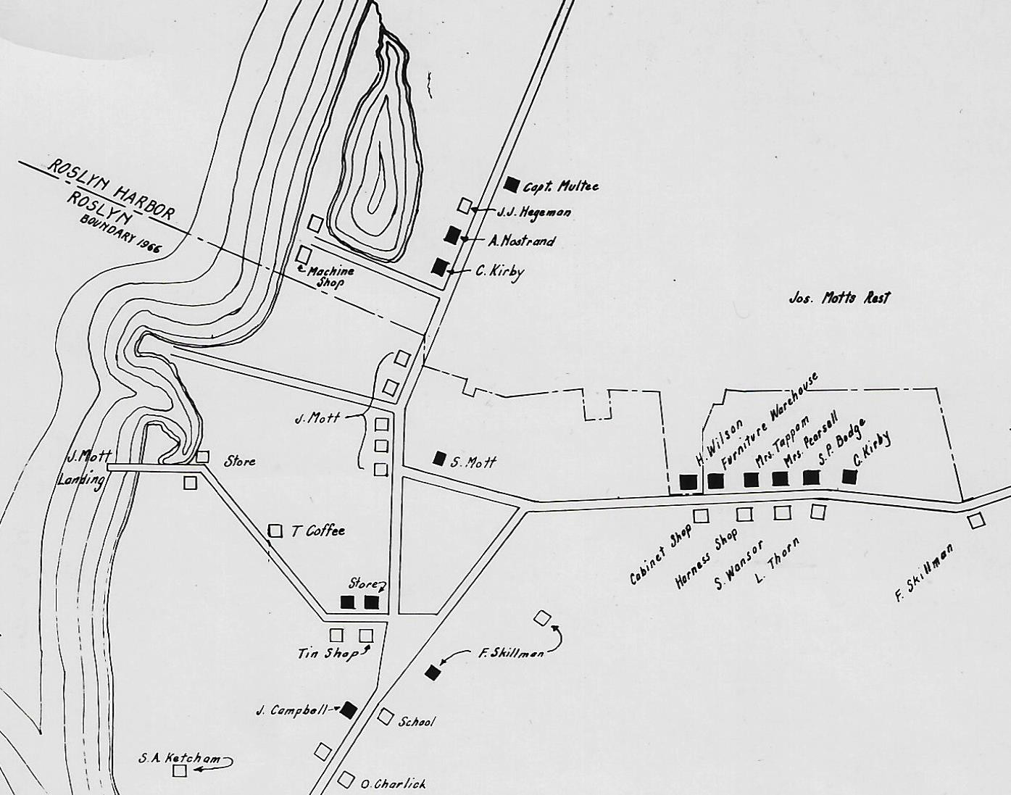

Slide 10
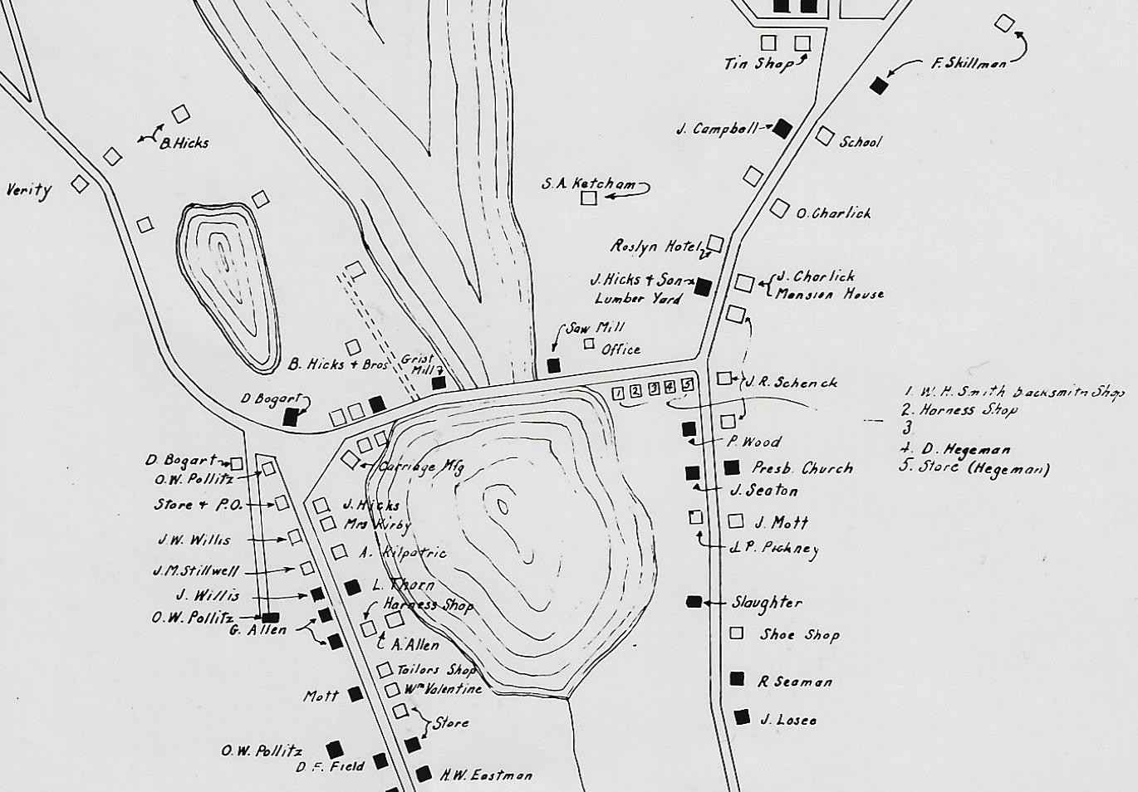

Slide 11
